Slide 1
Updates 21 December 2021

Slide 2
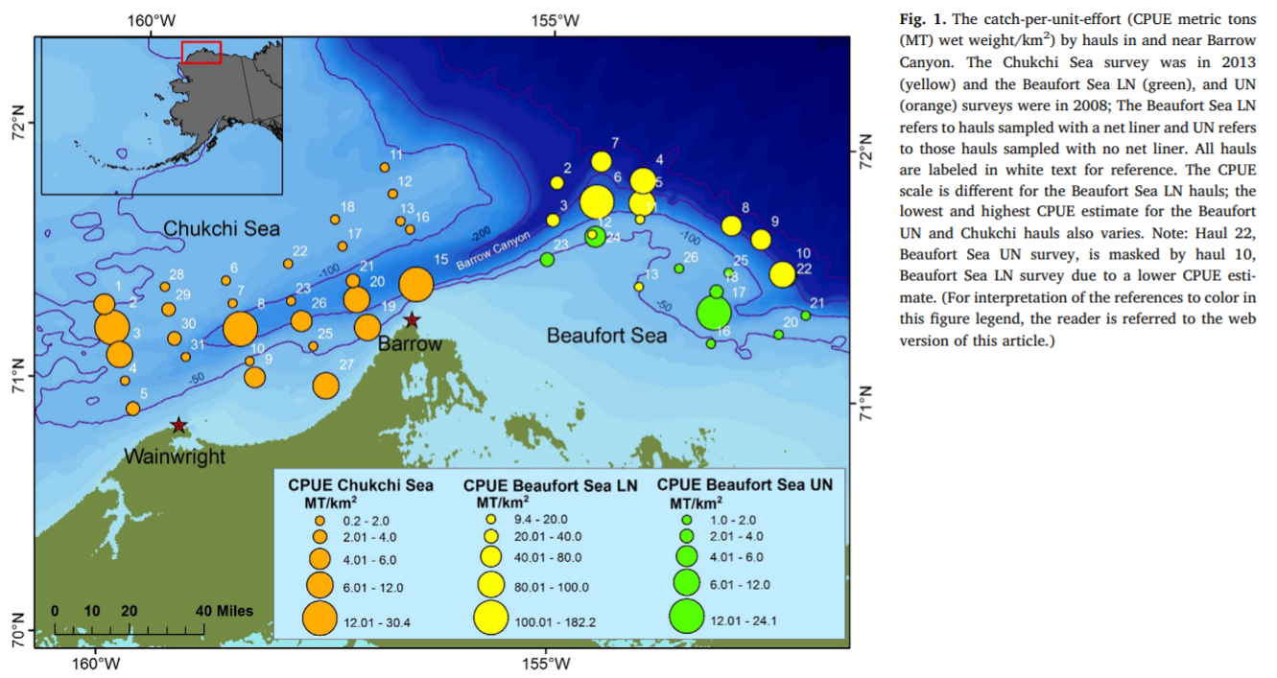
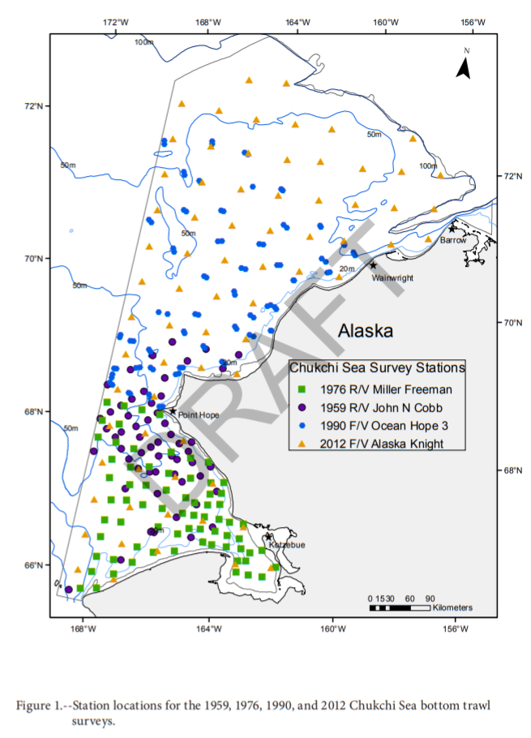

Slide 3
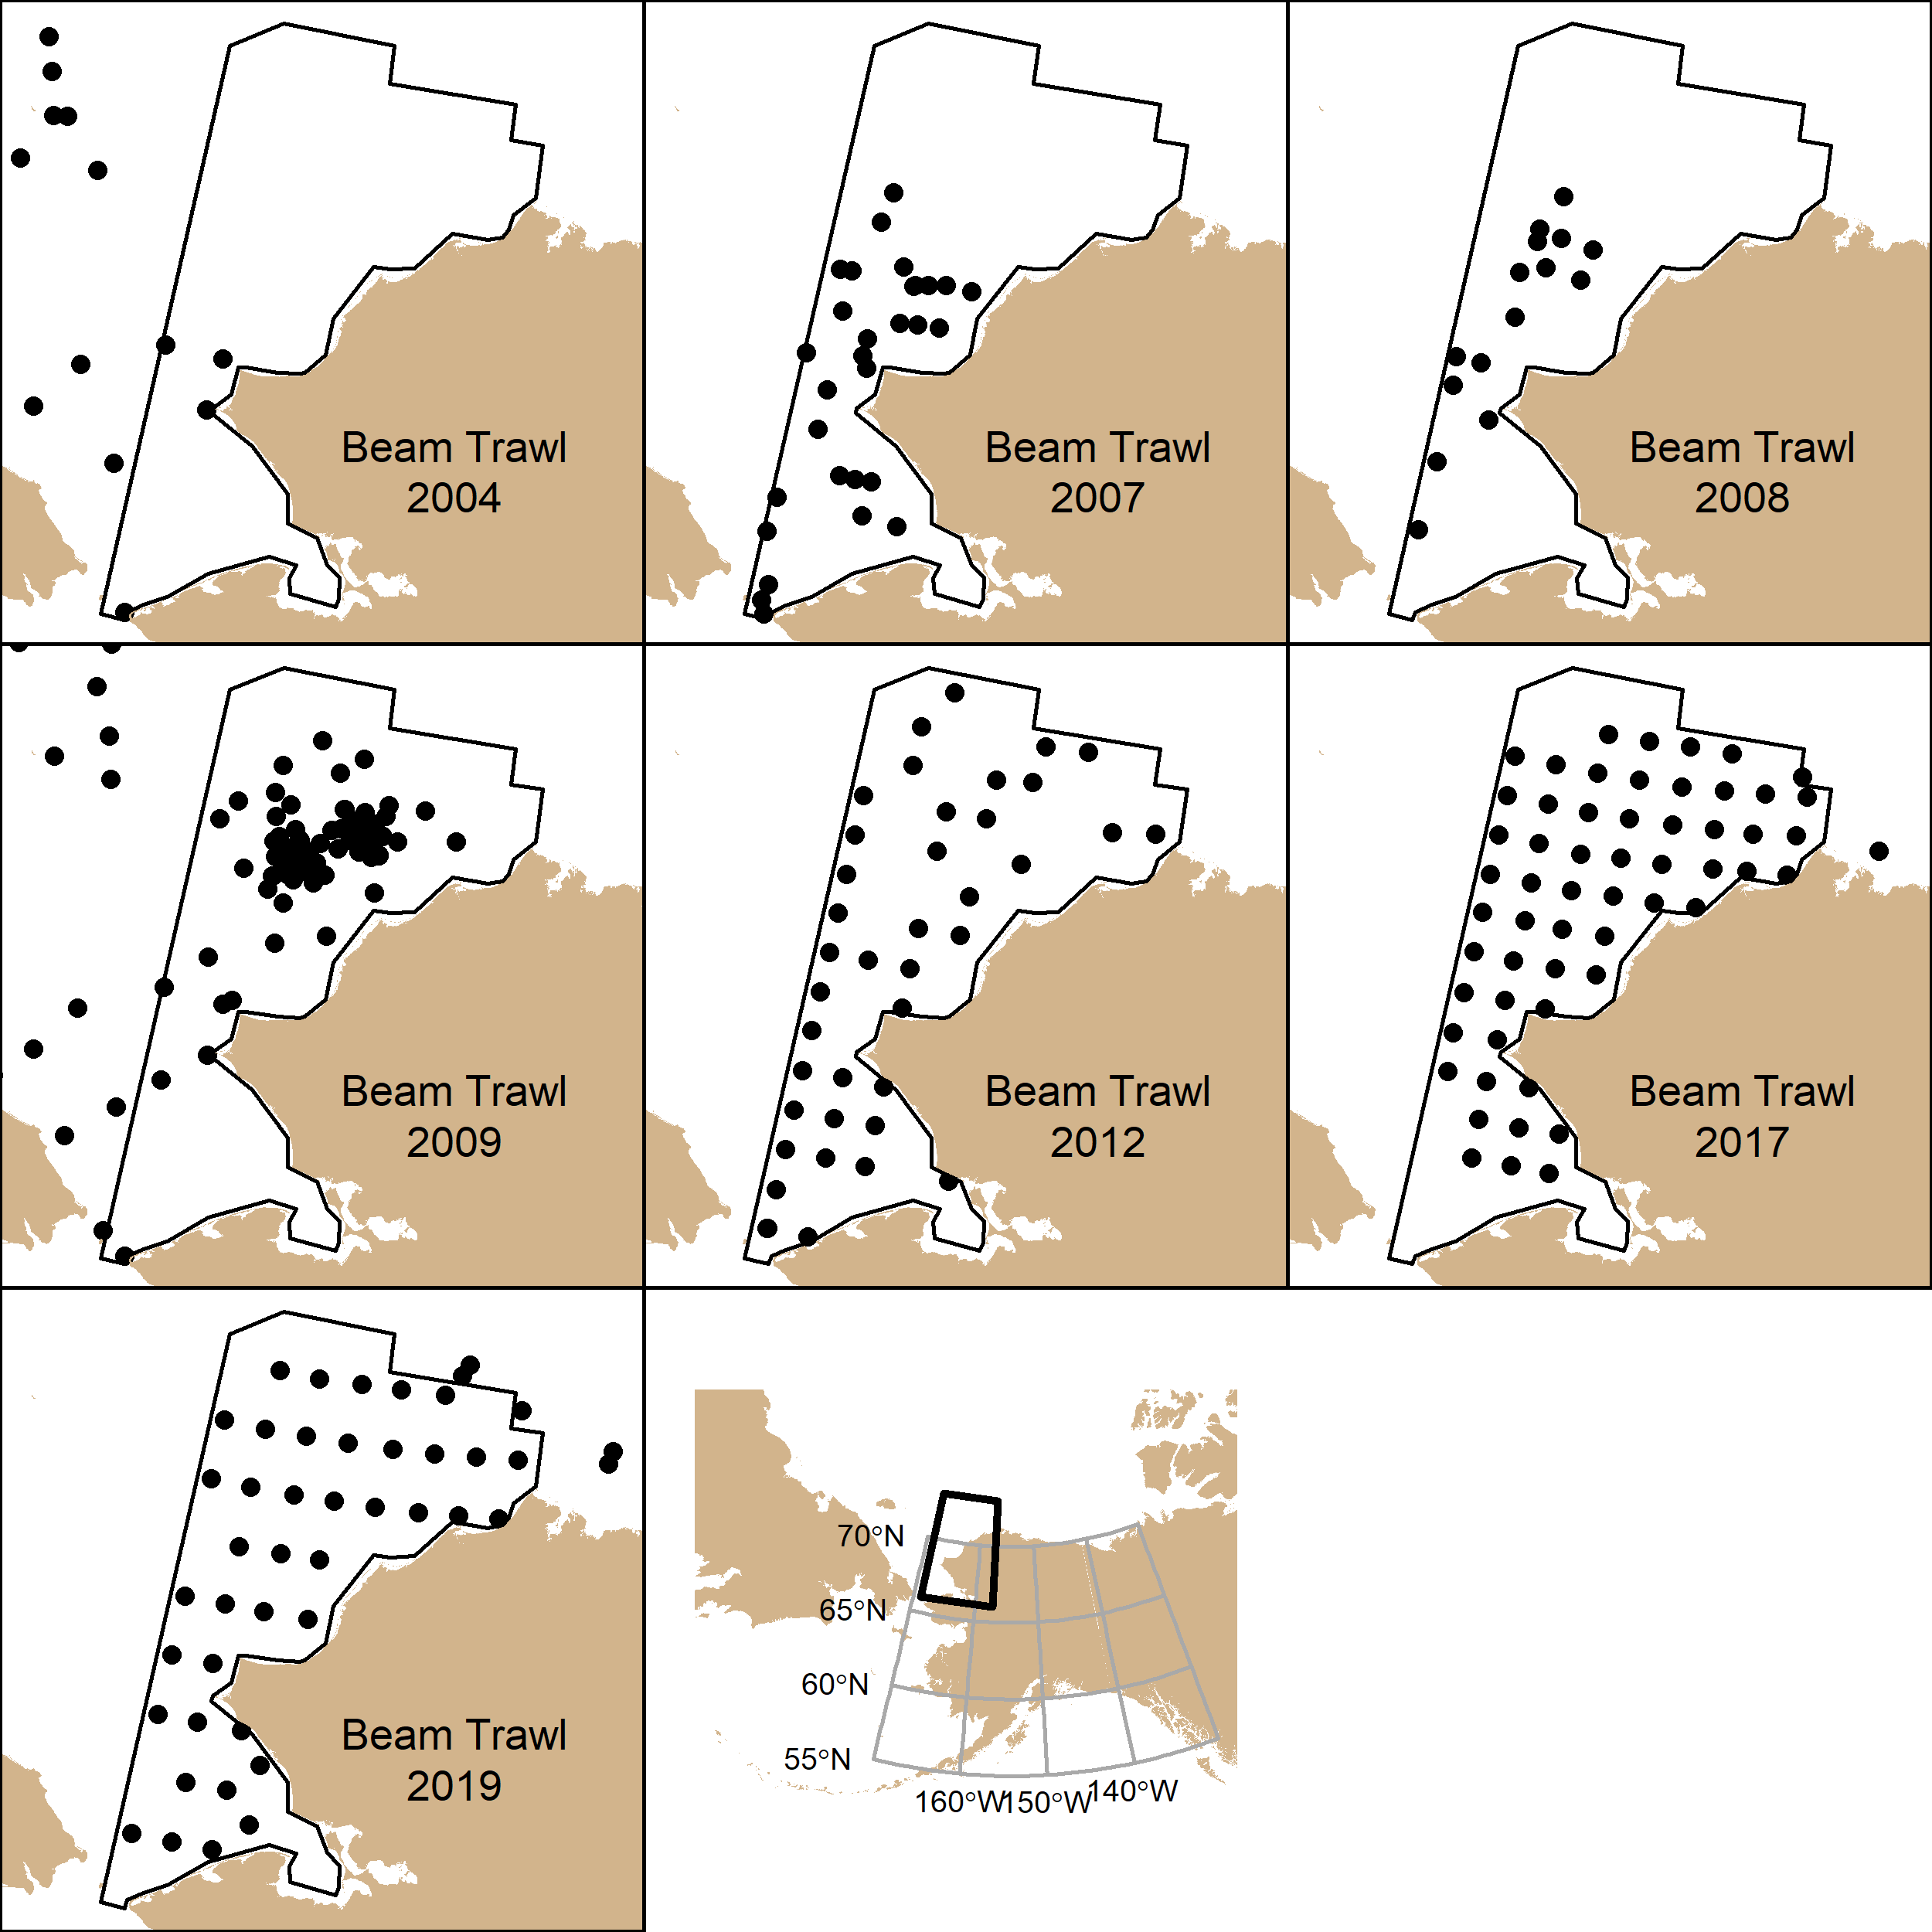
Years | Source
2004-2009 | ANIMIDA III
2012 | AFSC-RACE
2017, 2019 | IERP

Slide 4
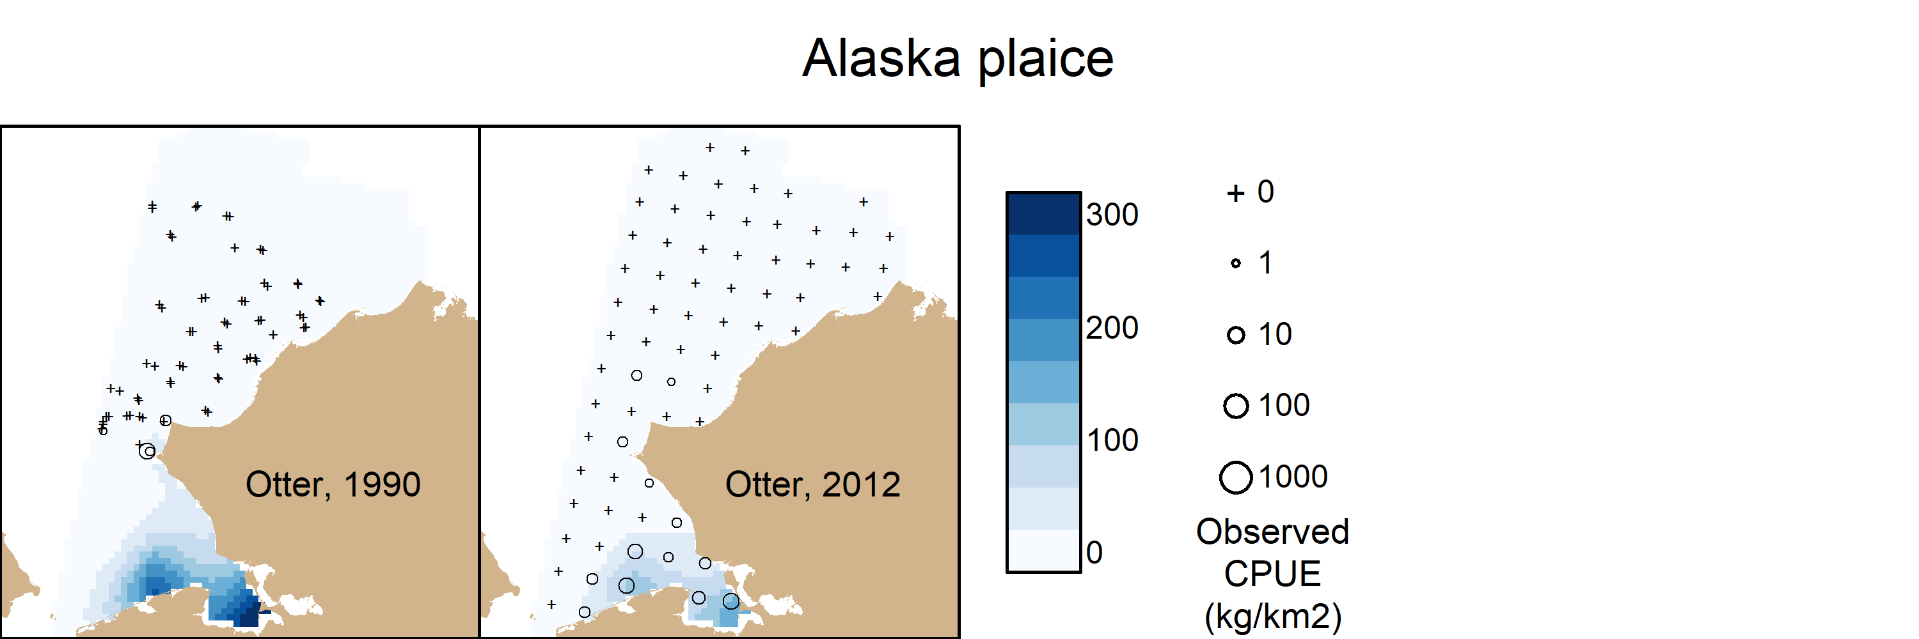
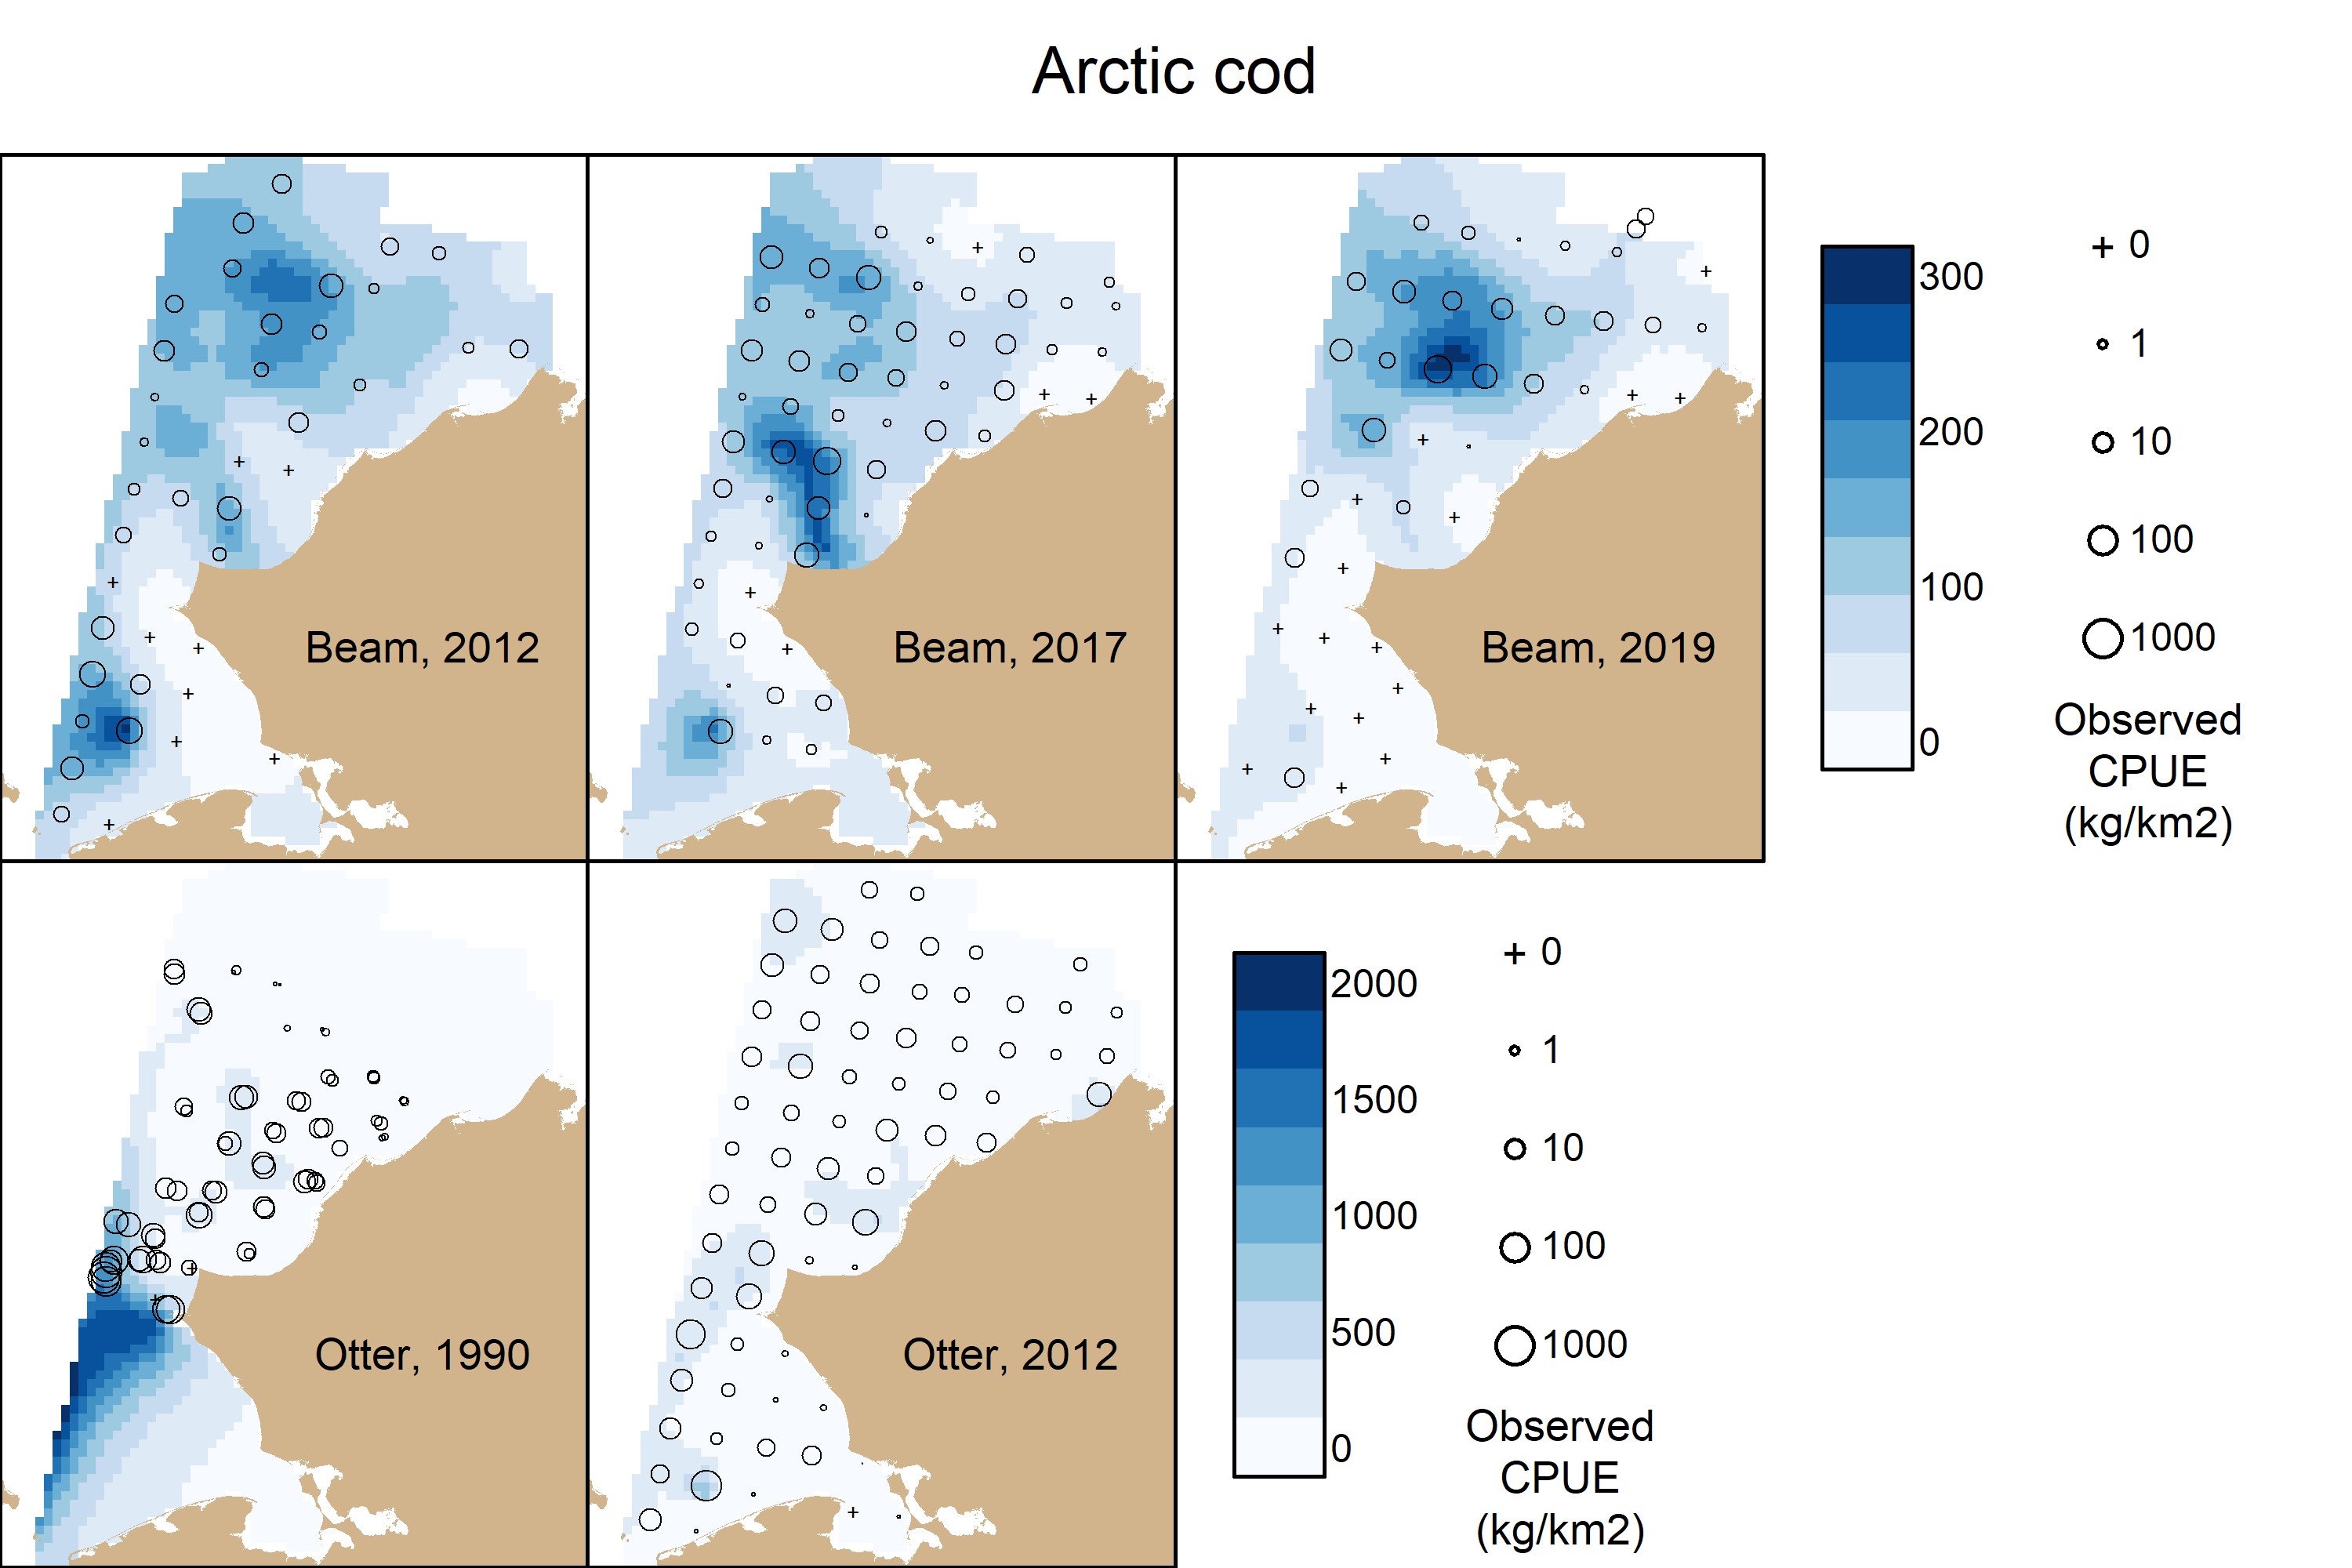
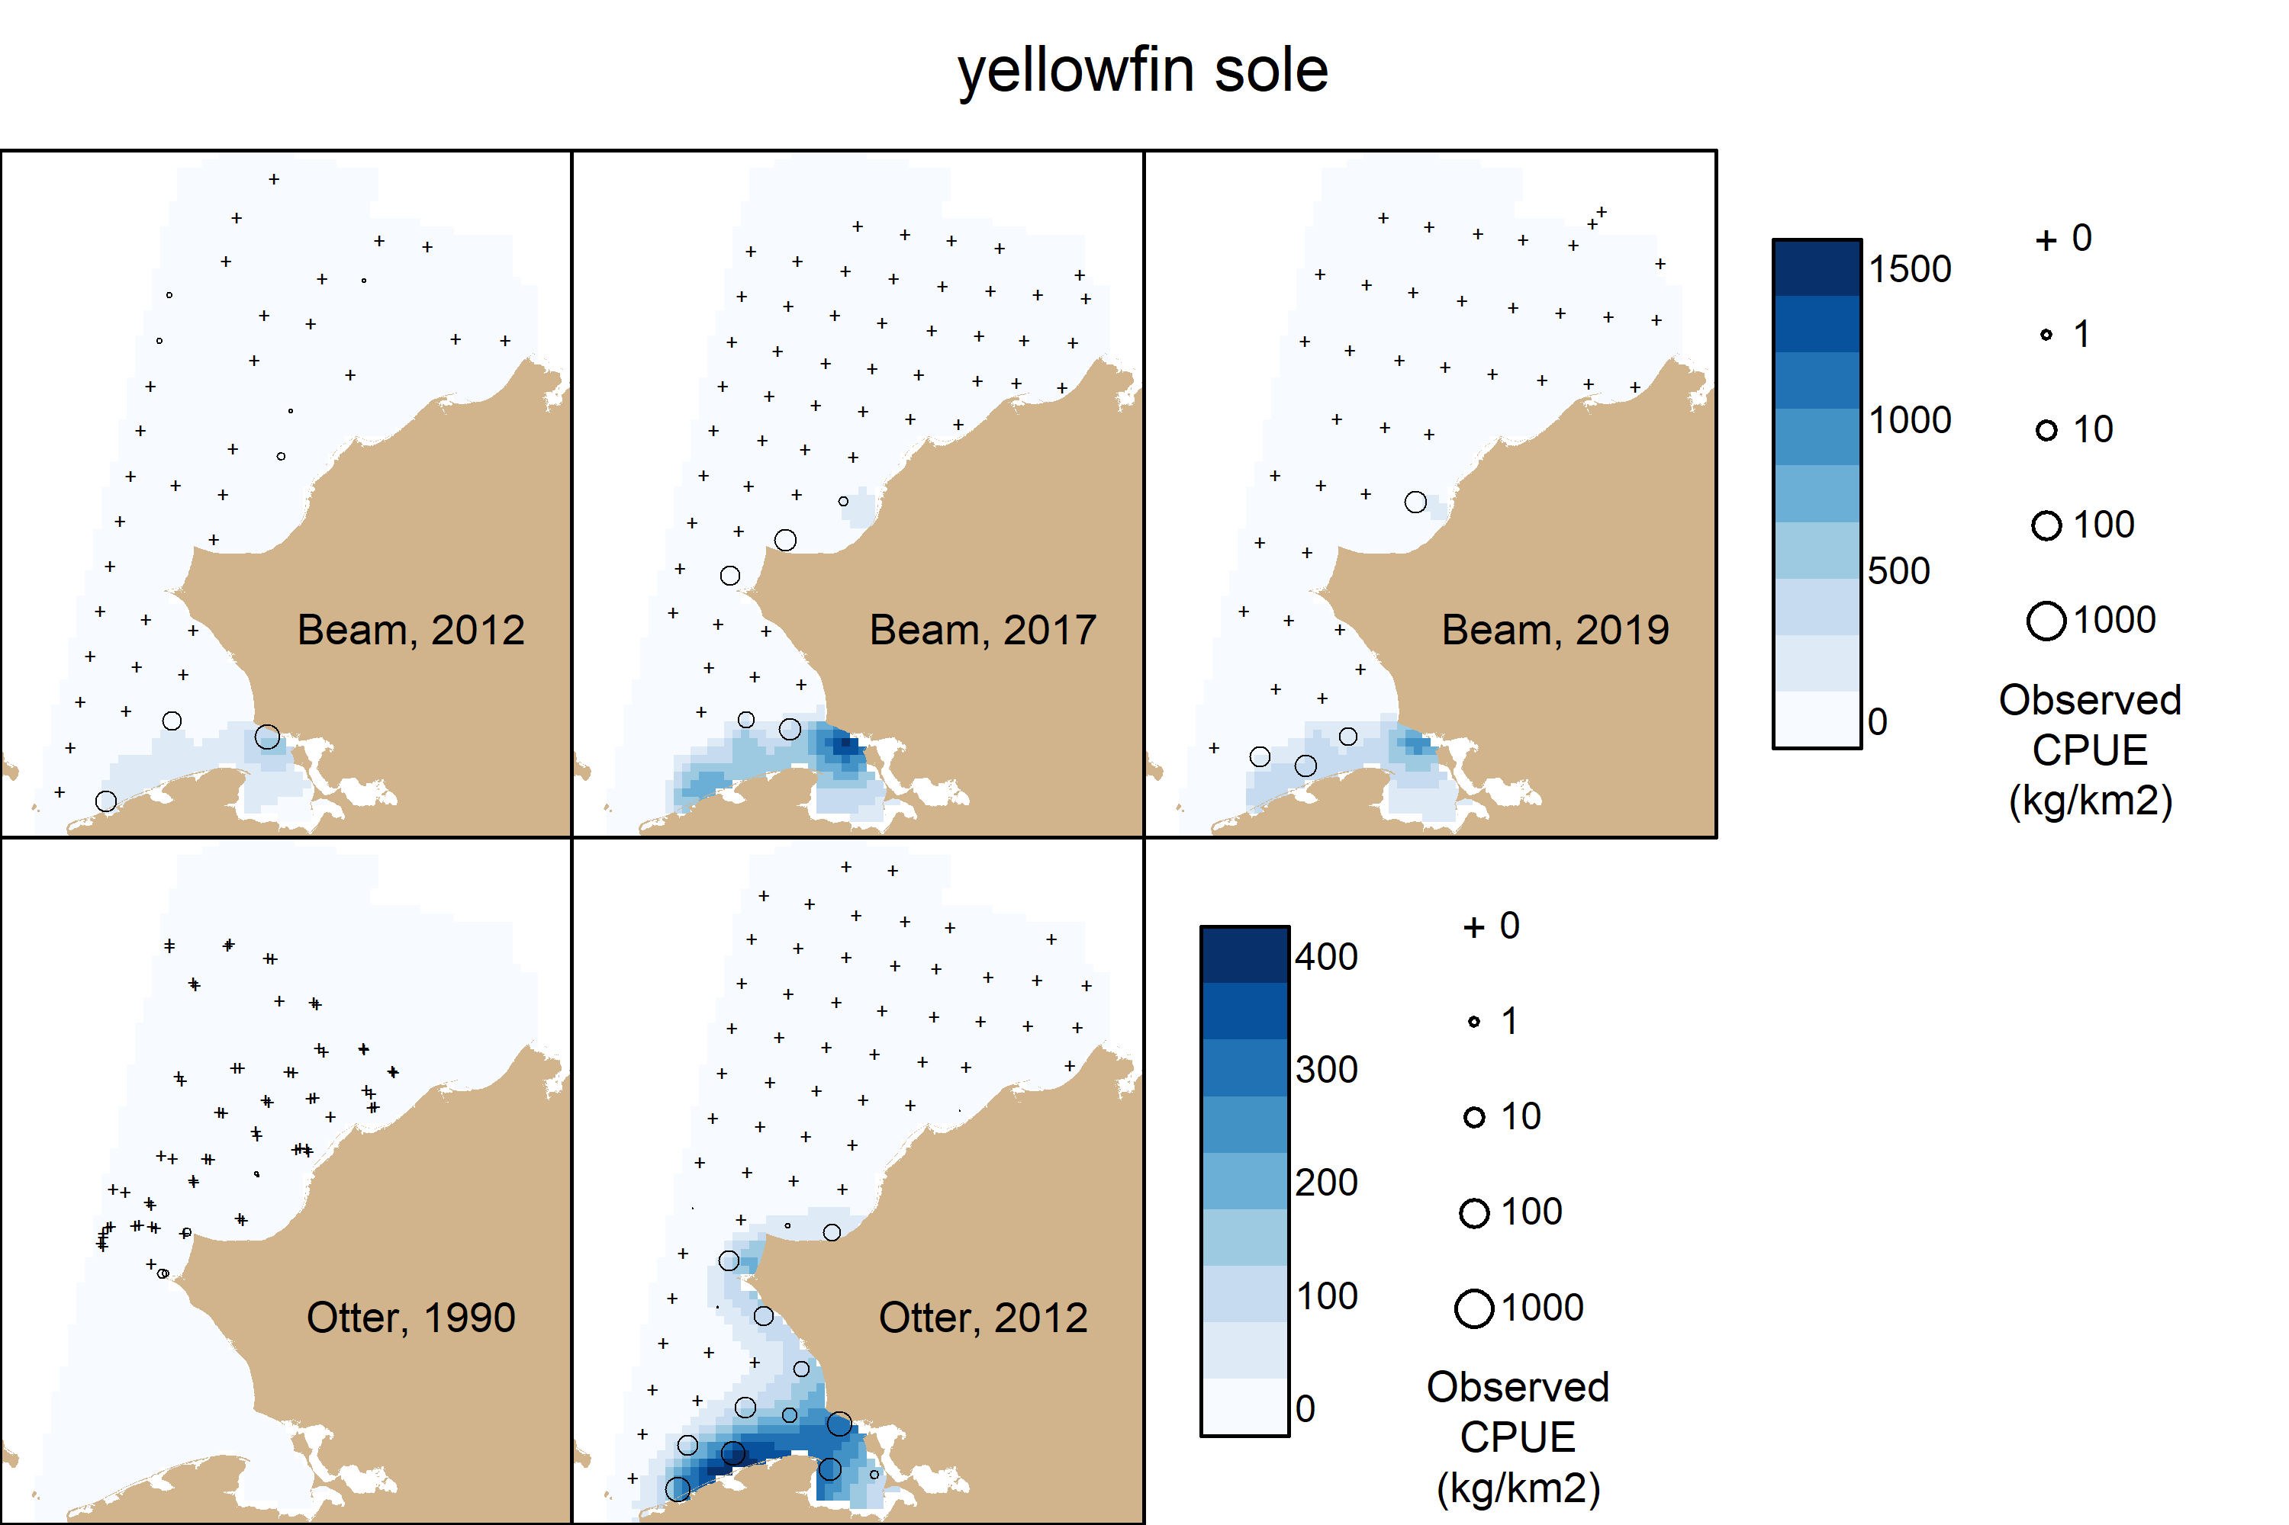

Slide 5
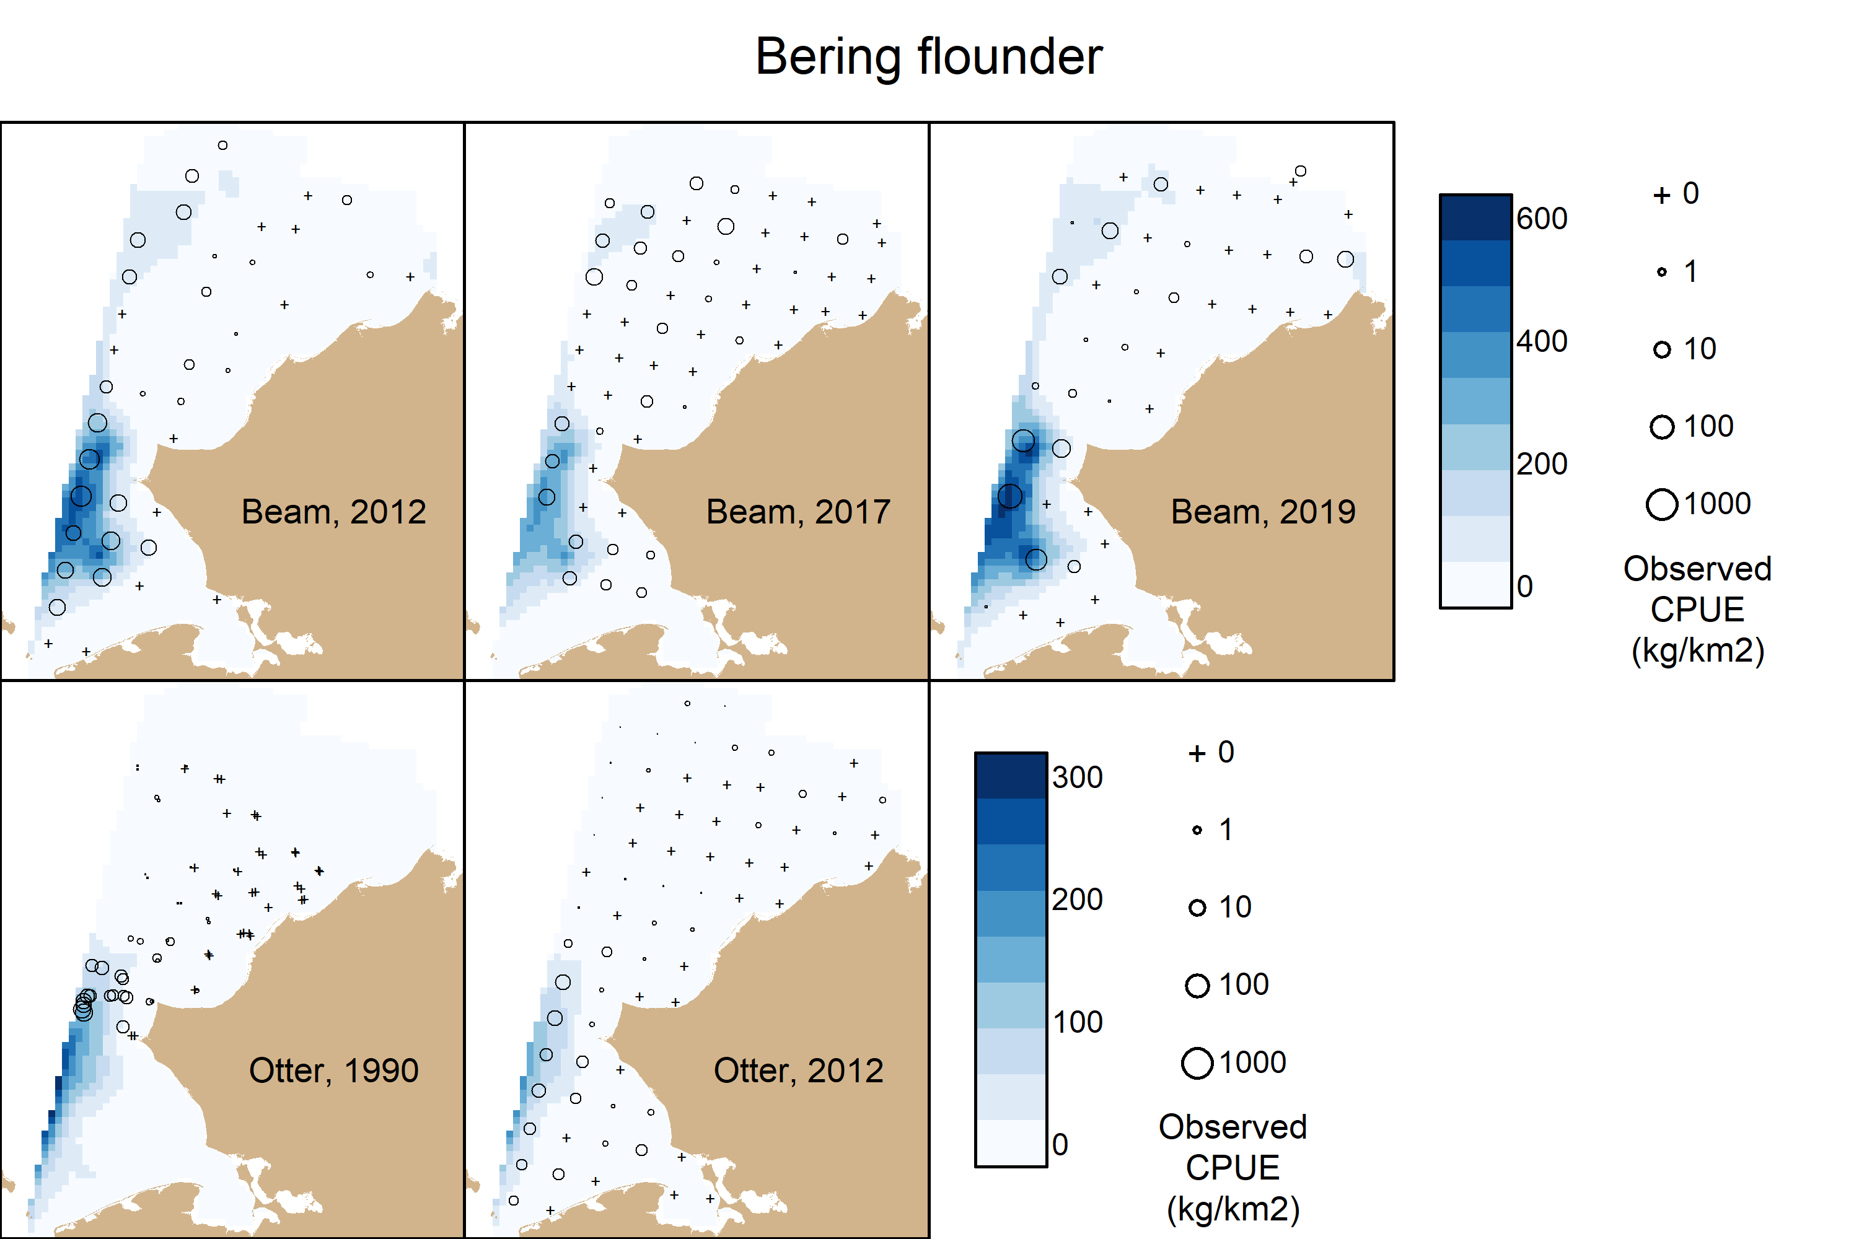
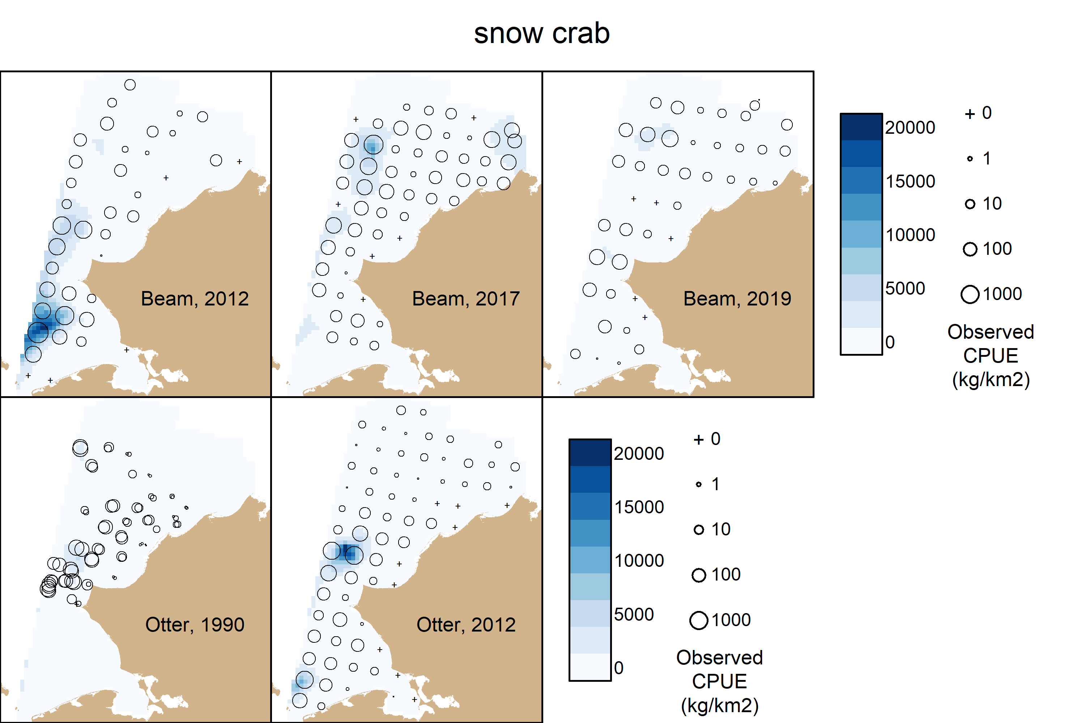

Slide 6
VAST CVs
 | Beam Trawl |  |  |  | Otter Trawl
 | 2012 | 2017 | 2019 |  | 1990 | 2012
Number of stations | 42 | 58 | 45 |  | 69 | 72
Species
Alaska plaice |  |  |  |  | 0.81 | 0.22
Arctic cod | 0.23 | 0.2 | 0.25 |  | 0.6 | 0.12
Bering flounder | 0.25 | 0.4 | 0.31 |  | 0.24 | 0.18
saffron cod | 0.62 | 0.57 | 0.58 |  | 1.51 | 0.85
snow crab | 0.24 | 0.2 | 0.25 |  | 0.4 | 0.31
walleye pollock |  |  |  |  | 0.47 | 0.23
yellowfin sole | 0.97 | 1.14 | 1.04 |  | 0.9 | 0.39

Slide 7
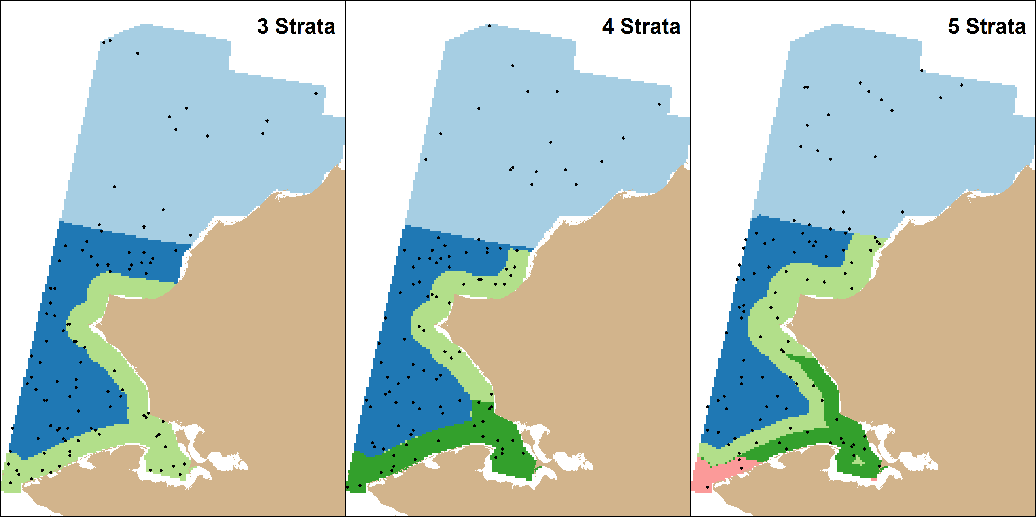
Otter Trawl- 3, 4, or 5 strata

Slide 8
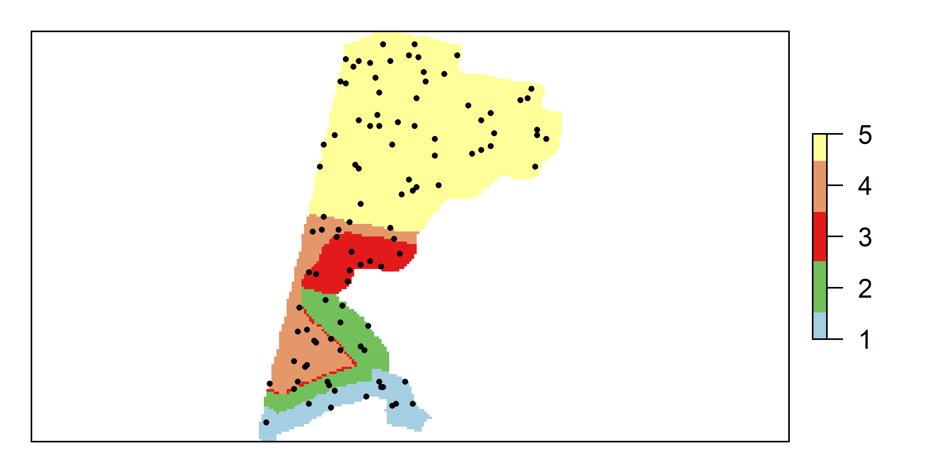
Beam Trawl, 5 strata

Slide 9
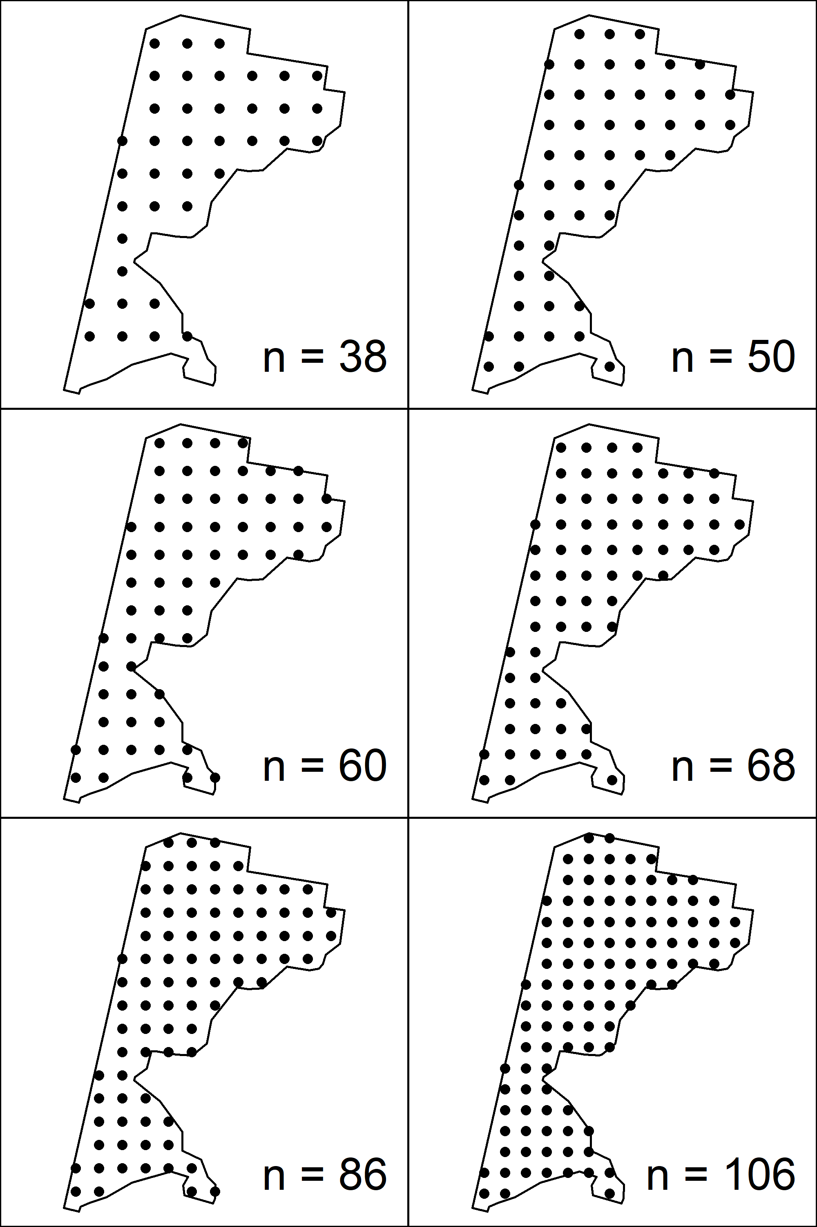
Other Designs
Systematic with different sampling densities
Simple Random

Slide 10
